Slide 1



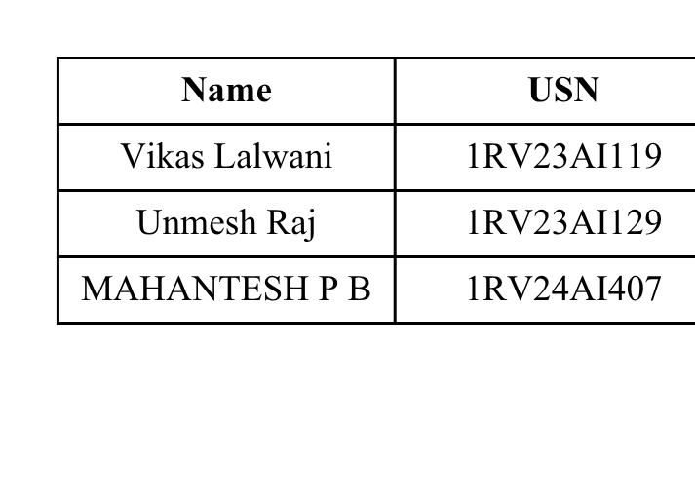
SPA Phase I
Project Review
“Real-Time Ride-Hailing Demand Prediction ”
Under the Guidance of :
Dr. Vijayalakshmi M.N, Associate Professor, AIML
Dr. S Anupama Kumar, Associate Professor, AIML

Slide 2
Introduction
  Rapid urbanization and increasing mobility demand create challenges in efficiently matching ride supply with passenger demand.
  Ride-hailing demand varies significantly with time, location, day of week, weather, and special events.
  Static or historical analysis alone cannot provide timely information about changing demand.
  A real-time system can continuously process ride requests and estimate current and near-future demand across Bengaluru zones.
  Apache Kafka is used as the real-time data streaming backbone for handling continuous ride-request events.
  Machine learning is applied to historical and streaming demand patterns to predict demand for the next time interval.
  The proposed system aims to support better driver allocation, demand monitoring, and operational decision-making.

Slide 3
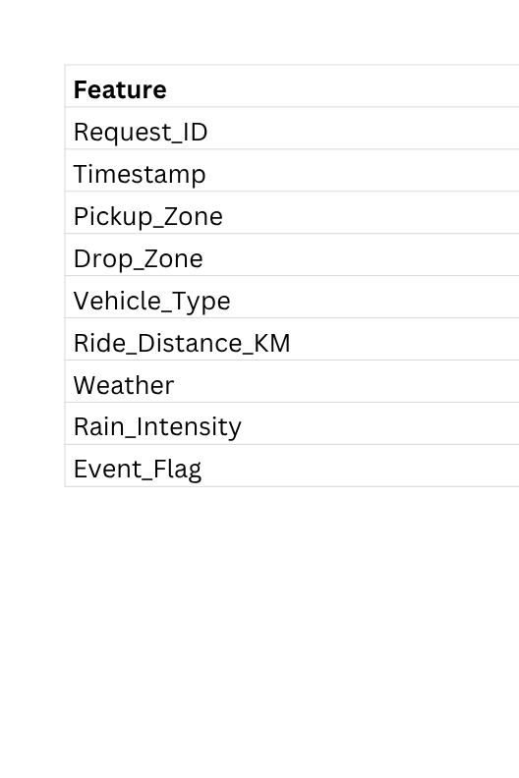
Dataset Description
  Synthetic Bengaluru Ride-Hailing Dataset
  Geographical scope: Bengaluru, Karnataka
  Data type: Synthetic individual ride-request events
  Time period: July–August 2026
  Spatial granularity: 50+ Bengaluru zones
  Unit of observation: One row represents one ride request
  Data generation: Stochastic simulation designed to reproduce realistic temporal and spatial mobility patterns

Slide 4
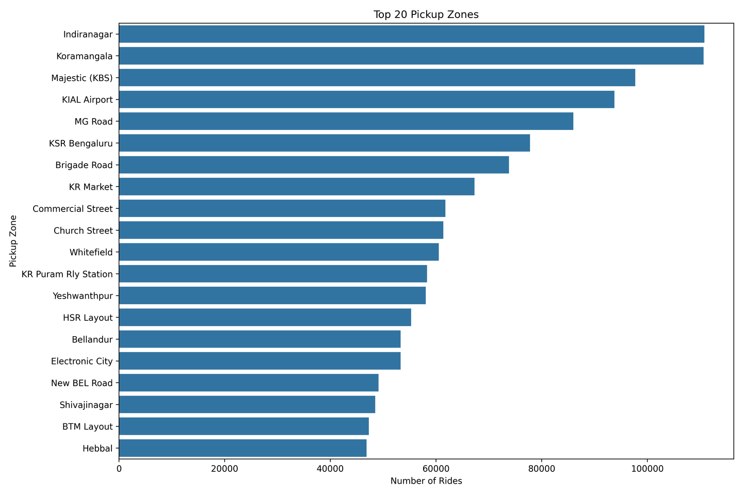
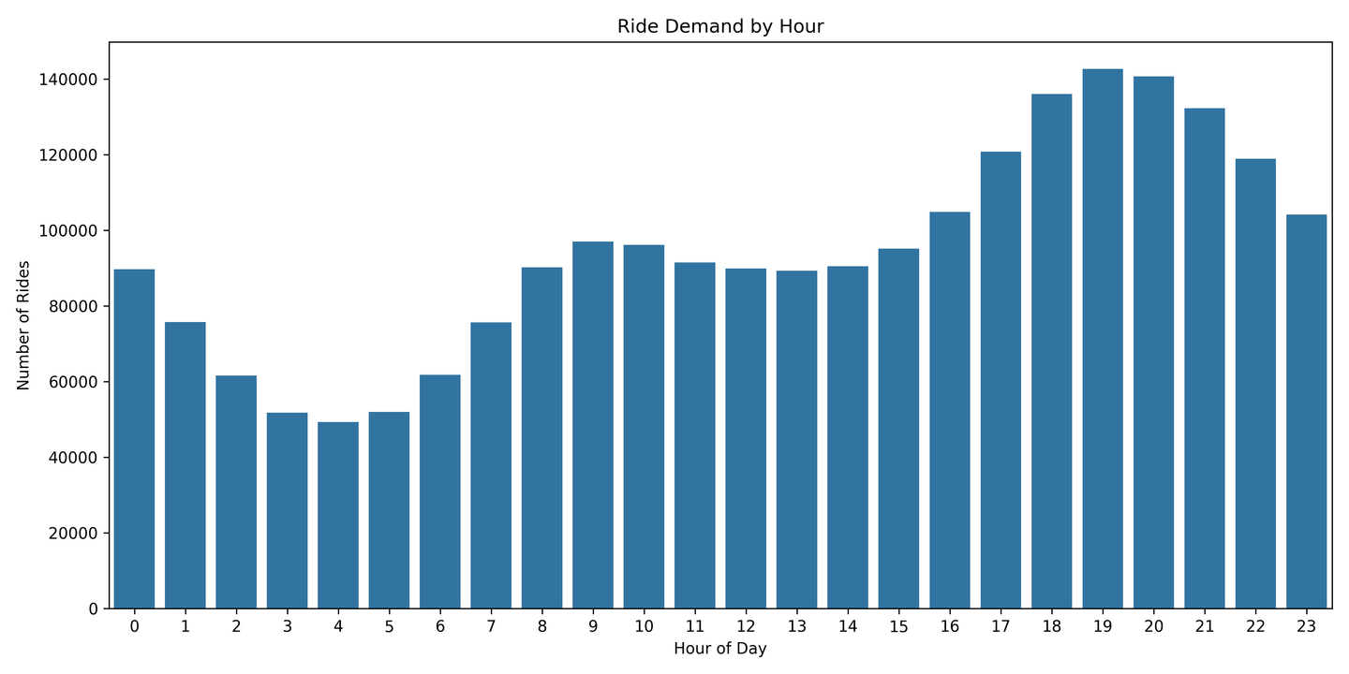
EDA Results

Slide 5
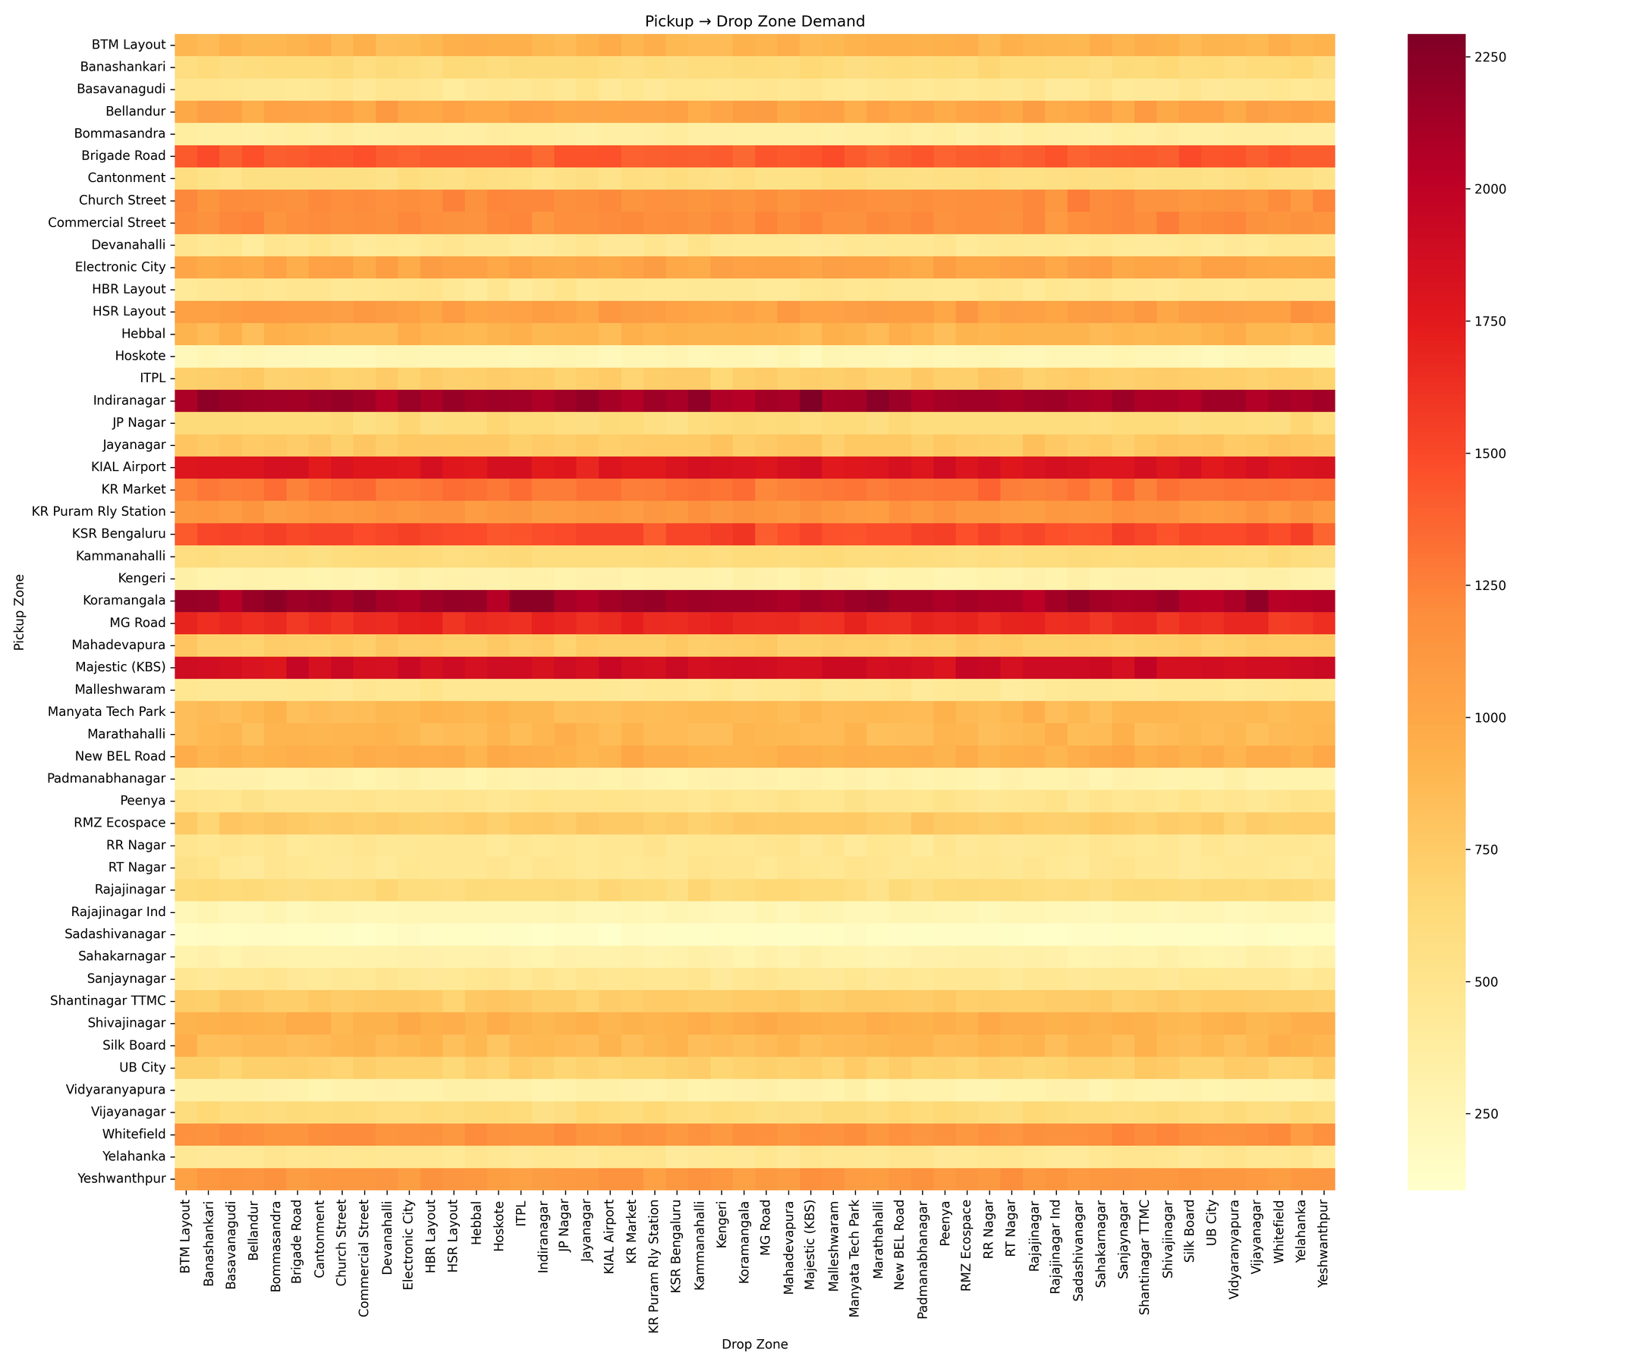
EDA Results
  Temporal pattern: Demand varies significantly across the day, with a pronounced evening peak around 17:00–21:00.
  Weekly pattern: Friday and Saturday show higher overall demand compared with most weekdays.
  Spatial pattern: Demand varies considerably across Bengaluru zones, with areas such as Indiranagar and Koramangala showing stronger demand during evening/night periods.
  Short-term variation: 5-minute demand shows continuous fluctuations, demonstrating the need for real-time window-based processing.
  Forecasting relevance: The observed temporal and spatial patterns provide useful features for short-term zone-level demand prediction.

Slide 6
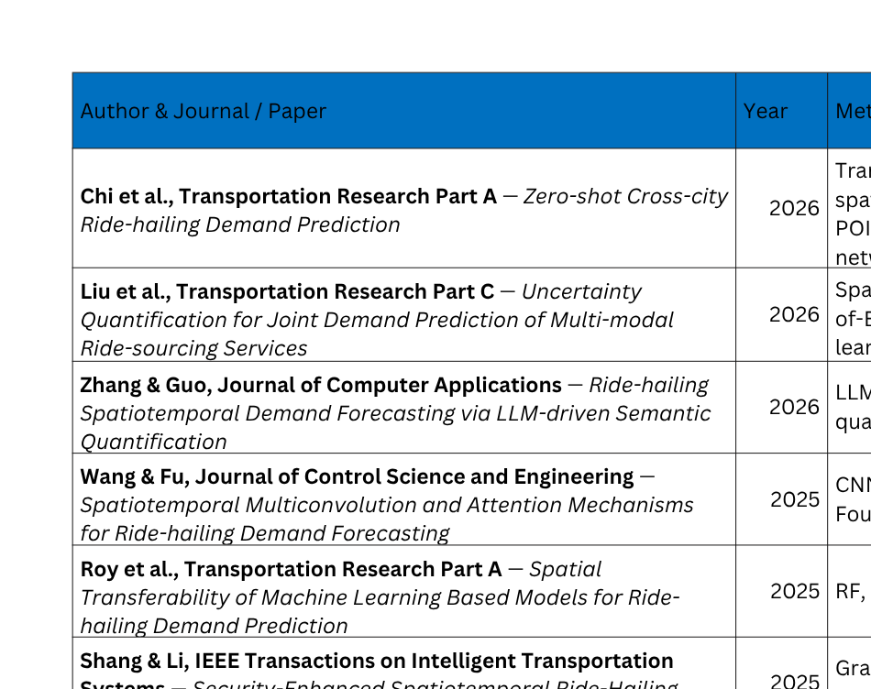
Literature Review

Slide 7
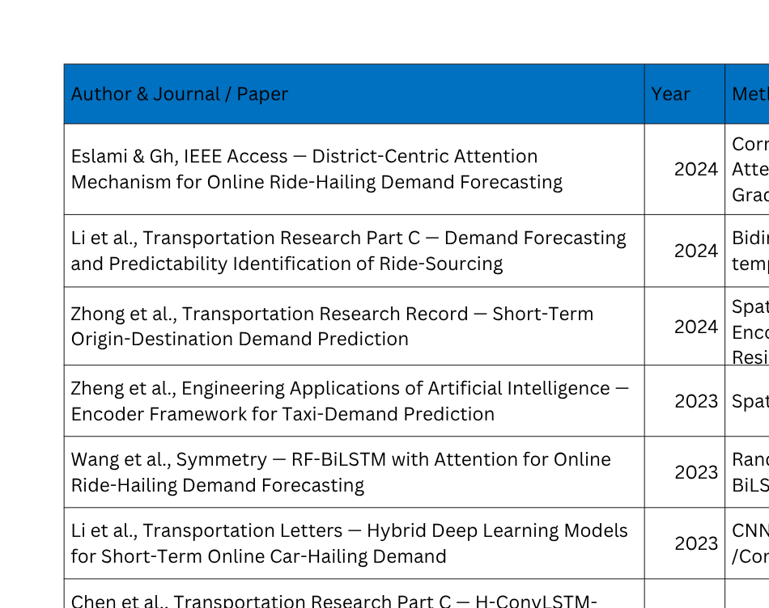
Literature Review

Slide 8

Literature Review

Slide 9
Summary of Literature
Recent studies establish that ride-hailing demand is strongly influenced by both temporal and spatial patterns. Factors such as time of day, day of week, previous demand and relationships between different zones are consistently identified as important for short-term demand forecasting.
The field has evolved from traditional machine-learning approaches such as regression, Random Forest and KNN toward LSTM, ConvLSTM, Graph Neural Networks, attention mechanisms and Transformers. Studies also increasingly incorporate contextual factors such as weather, holidays, events, POIs and other urban characteristics to improve prediction accuracy and robustness.
However, most existing research primarily focuses on developing increasingly sophisticated prediction models rather than implementing a complete real-time forecasting pipeline. This creates an opportunity to integrate real-time Kafka-based data streaming, window-based demand aggregation, machine-learning prediction, data storage and visualization into a single end-to-end system for Bengaluru.

Slide 10
Objectives
  To develop a real-time ride-hailing demand prediction system for Bengaluru using Apache Kafka.
  To analyze and extract temporal and spatial patterns from streaming ride-request data for zone-level demand estimation.
  To develop and evaluate machine-learning models for short-term ride-hailing demand prediction across Bengaluru zones.
  To implement a fault-tolerant streaming architecture using Kafka topics, partitions, consumer groups and recovery mechanisms.
  To store and visualize real-time demand predictions for continuous monitoring of ride-hailing demand across Bengaluru.

Slide 11
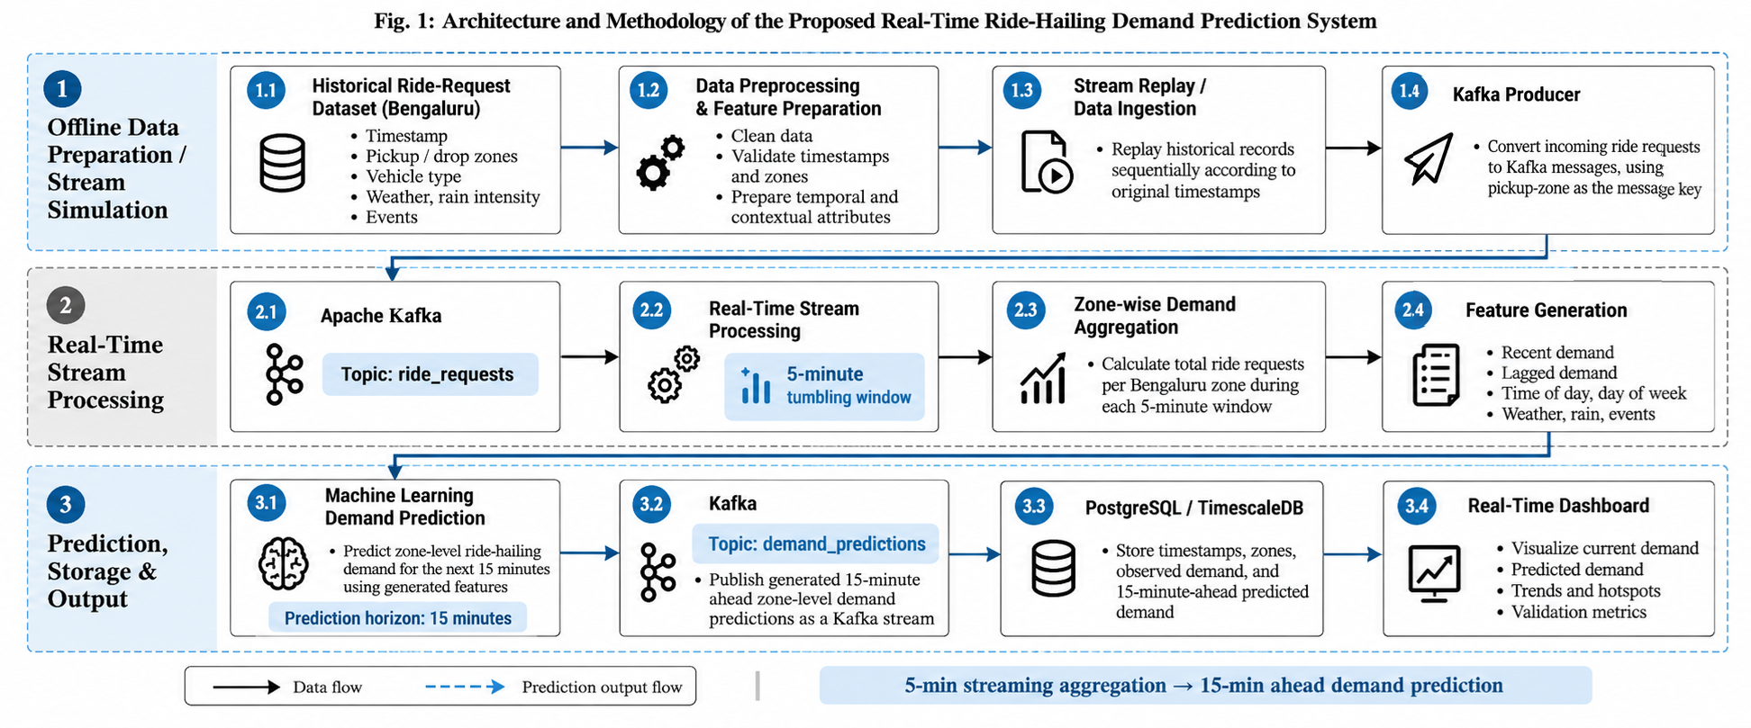
Methodology

Slide 12
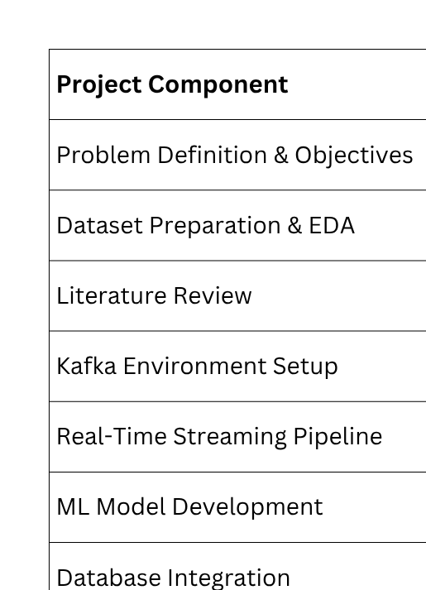
Work Completed

Slide 13
Thank You

